Slide 1
Tracebility for semi-complete goods(PCB)
Yuichiro Yamaji
2026/Jul/10
MagBG BMS Dep

Slide 2
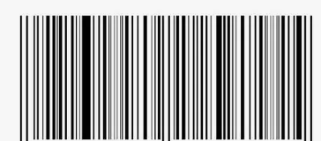
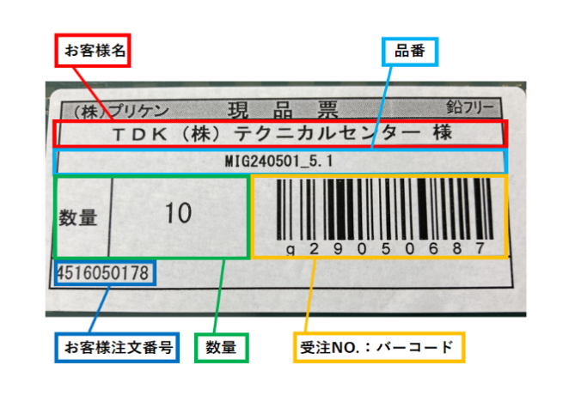
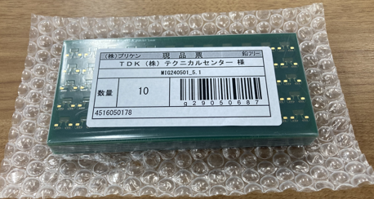
Procedure step to generate Semi-complete Travel card
Step1: Malen will request what raw model to cutout
Step2-1: Star will check supplier model # make request sheet
Step2-2: Star will put a check on request sheet
Step2-3: Malen will check the request sheet and ok approve.
Pass the sheet to Shee
Request Sheet (Machine)
Checker
Approver
MIG240501 1sheet
Step3: After receive the request sheet, “Shee” will find the material
And print the machine label (see right)
Supplier label
Machine Label (Print bellow label)
Priken PCB
lot#g29050687 MIG240501 1sheet

Slide 3
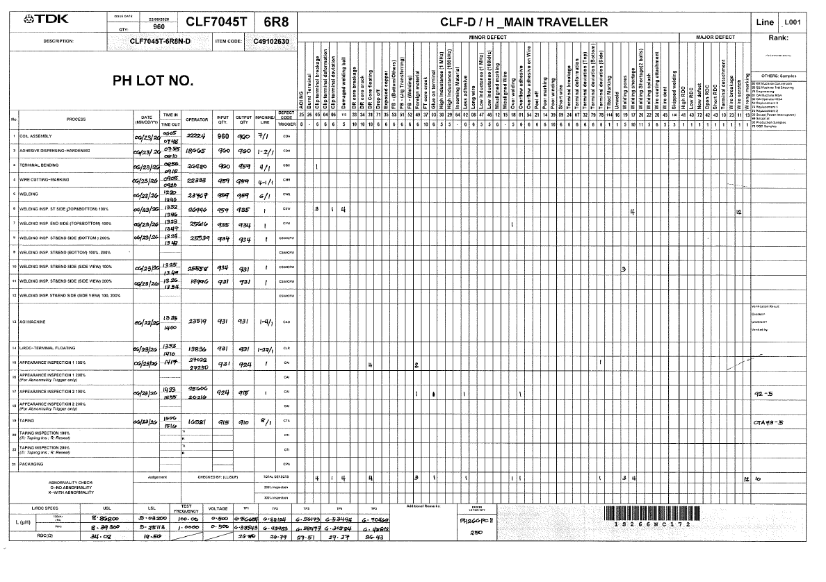
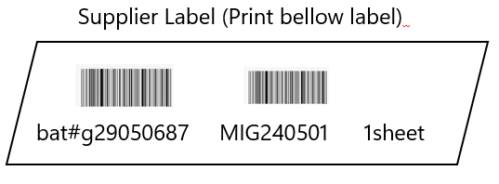
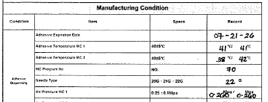
Procedure step to generate Semi-complete Travel card
Step4: “Shee” will Pass material(1set) & Machine label to Star, after Star checking material is
correct Star will generate Semi-complete Travel card. Star will pass Semi-complet Travel card and
materials to Machine side.
Semi-complete Travel card (front side)
Semi-complete Travel card (back side)
Label
Attach Machine label on backside
(This is for traceability what supplier Lot used)
Control items
Batch number: This will follow supplier lot# + “serial number”
Example bat# g29050687001

Slide 4
Procedure step to generate Semi-complete Travel card
Step5: Machine side operator will proceed to the end of Travel card
Step6: After the Machining process is complete operator will print semi complete label (5 sheet, (4 for backup))
Put bellow 3 items in box
・semi complete material: 1 set
・Semi-complete Travel Card: 1 sheet
・Semi complete Label: 5 sheet
Semi complete Label (2 sheet)
Bat# g29050687001 MIG240501 58pcs
Semi-complete Travel card
Storage box

Slide 5
Procedure step to generate Semi-complete Travel card
Step7: Operator will pass to “Shee”
Step8: “Shee” will do put in storage (First in First out). Scan Semi complete Travel card and bat#
(Link raw material Lot# and Semi-complete bat# and qty)

Slide 6
Tracebility for semi-complete goods(Back splitter assembly)
Yuichiro Yamaji
2026/Jul/10
MagBG BMS Dep

Slide 7
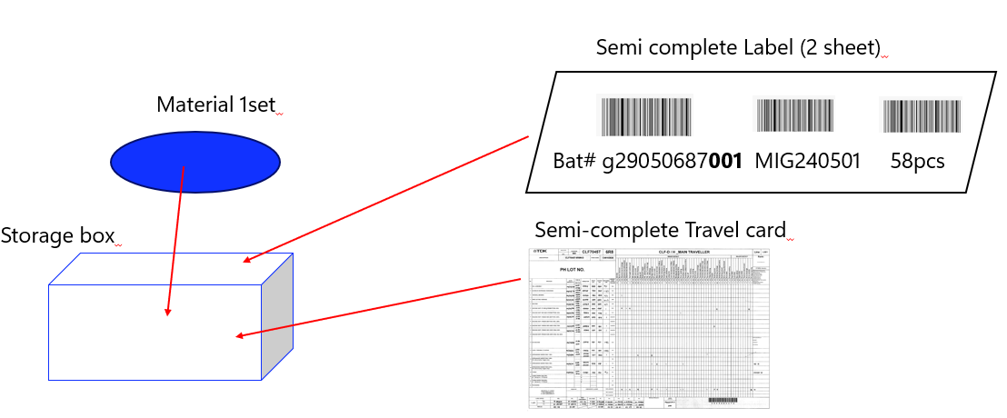
Procedure step to generate Offline Travel card
Step1: Malen will request to do off line assembly
Step2-1: Jecille will check batch # make request sheet
Step2-2: Jecille will put a check on request sheet
Step2-3: Malen will check the request sheet and ok approve.
Pass the sheet to Shee
Request Sheet (Offline)
Checker
Approver
M1BS0305 30pcs
Step3: After receive the request sheet, “Shee” will find the requested semi complete material,
Shee will check material model no and qty and Pass to Jecille

Slide 8
Procedure step to generate Offline Travel card
Step4: “Shee” will Pass material(1set) & Semi complete label to Jecille, after Jecille checking material and
qty is correct Jecille will generate offline Travel card. Jecille will pass offline Travel card and
materials to Assembly side.
Offline Travel card (front side)
Off line Travel card (back side)
Label
Attach semi complete Label on backside
(This is for traceability what bat# used)
Control items
Batch number: ○○+260710+001

Slide 9
Procedure step to generate Offline Travel card
Step5: Assembly side operator will proceed to the end of Travel card
Step6: After the offline process is complete operator will print offline complete label (5 sheet, (4 for backup))
Put bellow 3 items in box
・semi complete material: 1 set
・Off line Travel Card: 1 sheet
・Offline complete Label: 5 sheet
Offline complete Label (2 sheet)
Bat# g29050687001 MIG240501 58pcs
Offline Travel card
Storage box

Slide 10
Procedure step to generate Semi-complete Travel card
Step7: Operator will pass to “Shee”
Step8: “Shee” will do put in storage (First in First out). Scan Off line Travel card and bat#
(Link raw material Lot# and Semi-complete bat# and qty)

Slide 11
Tracebility for BMS product
Yuichiro Yamaji
2026/Jul/10
MagBG BMS Dep

Slide 12
Format of request sheet
Request sheet
Customer info
Name customer, qty of sensor, PO#, item code
Issue Date
Request sheet No
Material List
No | Model No | Barcode(model no) | Qty/weight
1 | MIG240501 |  | 30 pcs
2
3
4
Checker
Approver
Malen
2026/Jul-10
Happee
2026/Jul-10

Slide 13

Format of request sheet
Assembly List
Issue Date
Material List
No | Model No | Barcode(model no) | Batch/Lot # | Barcode(bat#) | Qty/weight | Check
1 | MIG240501 |  |  |  | 30 pcs | ✓
2
3
4
Checker
Approver
Boss

Slide 14
Customer color code
0
0
0
Migne AnX MAGS-M01H-AB00P
1
0
0
0
Migne Asahi-Intec MAGS-M15V-AB00P
1
Nivio-S Customer K MAGS-M15V-AB00P

Slide 15
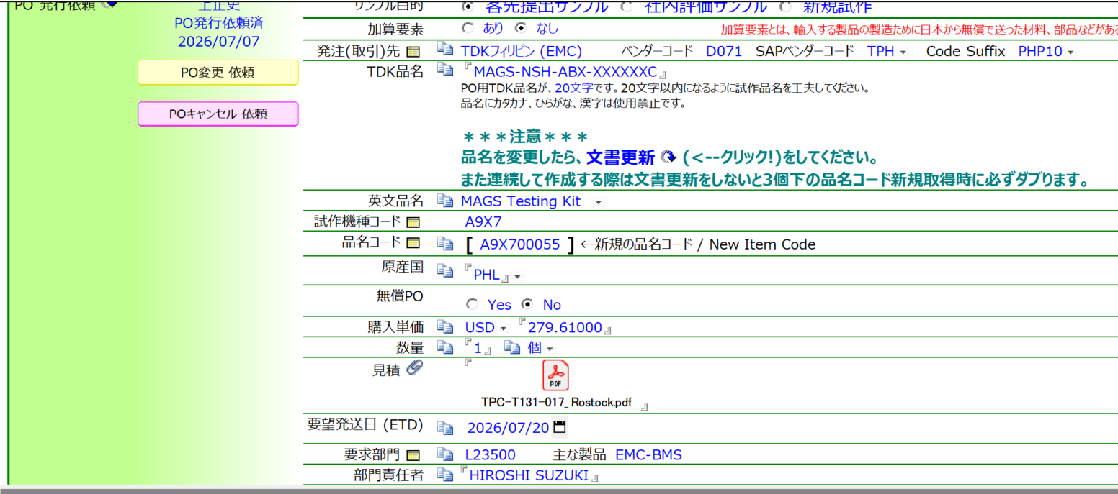
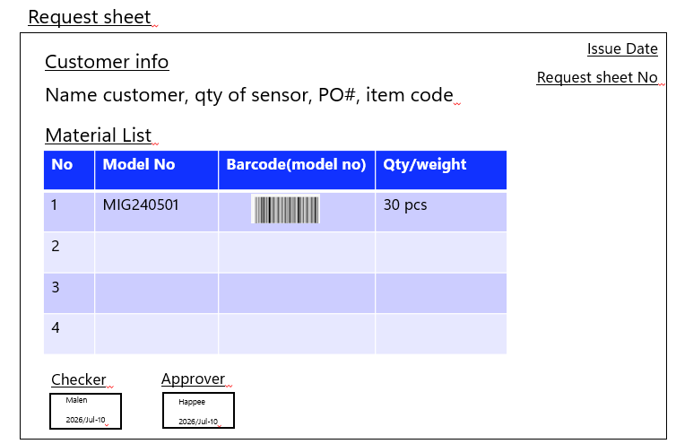
Procedure step to generate Travel card
Step1: Japan side will send PO to TPC
Step2:Happee will Pass PO information to Malen
Step3-1: Malen will check the PO and Malen make Request sheet. Put name in “Checker”
Step3-2: Malen pass sheet to Happee and Happee will check the list. If ok approve
Step3-3: Happee will pass Request sheet to Shee

Slide 16
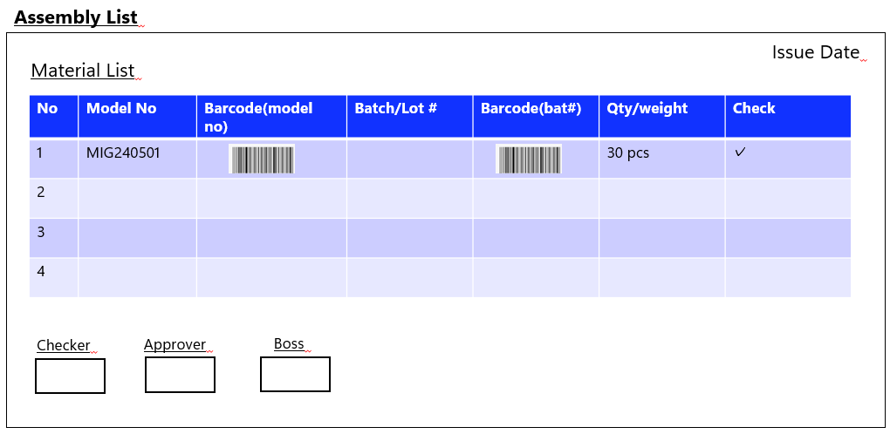
Procedure step to generate Travel card
Step4: Shee will compare the material # by barcode scan and print the Assembly list send to Malen (Data)
Step5 : Malen will compare Request sheet and Assembly List. (Malen will check Only model no)
Compare if match
Bar code scan

Slide 17
Procedure step to generate Travel card
Checker
Approver
Boss
Step6: If OK Malen will print Travel Card
And write name in checker, pass to Happee
Step7-1: Happee will receive Travel card and
Assembly list. Will Check qty is correct.
If OK approve in approver
Step7-2: Harakawa san will check OK to proceed
Assembly List
Attach Lot# of travel card
Step8: Happee will pass Assembly list back to “Shee” to proceed
“Shee” will receive Travel card and Assembly List (approved sign of Boss)

Slide 18
Procedure step to generate Travel card
Pass to assembly operator
Material tray
Travel Card
Step8: “Shee” will Pass the materials to each process station of assembly
M1SPMP264-00
Step9: operator will receive Travel card
Assembly list and materials.
For LTS entry bar code scan Travel Card
Lot# and Assembly bat#

Slide 19
Procedure step to generate Travel card
Step9: After packaging is done. Put bellow item in 1 file
・Travel Card
・Invoice and Shipment paper
・Assembly list
・Request Sheet

